Slide 1


Enhancing Urban Vision - The Role of Virtual Reality in Architecture and Urban Planning
Urban vision is crucial for architecture and urban planning. Traditional approaches have limitations that can be overcome with virtual reality (VR) technology. VR can enhance visualization and improve design and planning with successful examples and future prospects.

Slide 2

Limitations of Traditional Approaches
1
2D Models are Limited
2
Expensive, Inefficient Processes
3
High Error Rates
Traditional models are flat and don't allow for full immersion in the design.
Traditional models take time and money to create and often, need revisions.
2D models result in misunderstandings, leading to errors in construction and poor design outcomes.

Slide 3
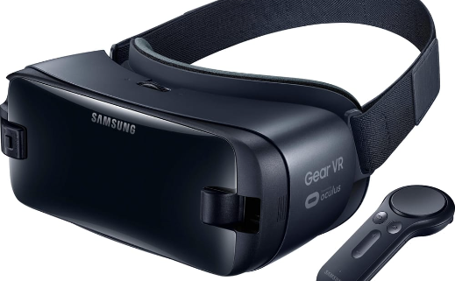
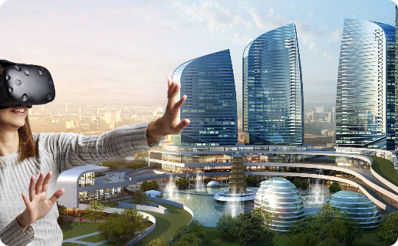
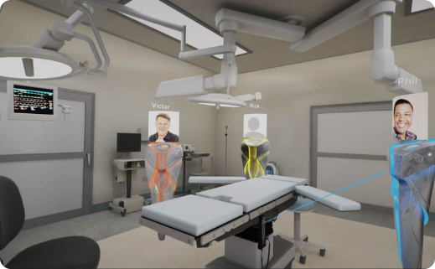
What is Virtual Reality?
Definition
Applications in Urban Vision
Benefits
VR is an immersive digital environment that simulates the feel of the real world with a combination of hardware and software.
VR offers a more immersive and interactive way to present urban developments and enhance the visualization process.
VR helps decrease construction costs by reducing the number of revisions needed, improving communication between stakeholders, and allowing for better decision-making processes.

Slide 4
Successful Case Studies
1
Oculus VR - The Wild
The Wild is a VR platform designed to help architects and urban planners collaborate in real-time and enhance their designs using a VR environment.
Archvirtual - Wayfair
2
Archvirtual created an immersive VR architecture tool to help Wayfair users visualize 3D models in a virtual environment, improving the customer experience and their understanding of interior design.
3
Dassault Systems - 3DEXPERIENCE Platform
Dassault Systems uses virtual reality to improve the efficiency and quality of communication between stakeholders and the use of 3D models for efficient design review and analysis.

Slide 5
Impact of VR on Urban Planning and Development
Better Decision-making
Improved Accessibility
VR allows for collaborative decision-making processes between architects, urban planners, and investors, resulting in better development plans and outcomes.
VR can help include disabled individuals' viewpoints in urban planning by making virtual environments accessible to all.
Increased Engagement
Cost-effective Solutions
VR can be used to engage communities to participate in urban development projects through virtual walkthroughs and simulations.
VR can help reduce construction costs by improving design efficiency and limiting revision processes.

Slide 6

Challenges and Consideration
1
Costs and Resources
VR technology is still relatively expensive and requires high-end computers and skilled personnel to create VR models.
2
Accessibility Issues
Not everyone has access to VR technology, and more research is needed to design VR for users of different demographics and abilities.
3
User Experience
VR needs to be user-friendly, have intuitive interfaces and user feedback, and be designed in such a way that doesn't cause nausea or fatigue.

Slide 7
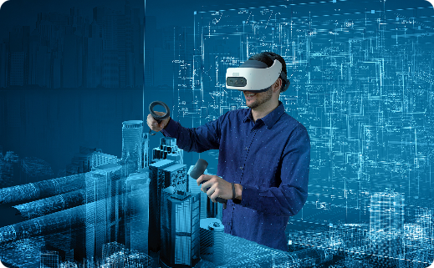
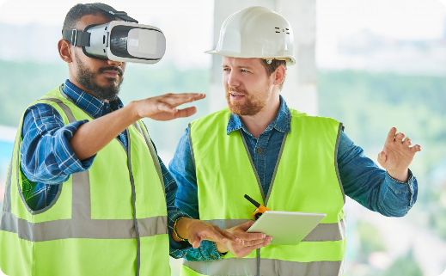
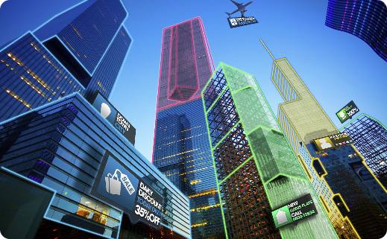
Future Prospects and Trends
Emerging Technologies
Integration into construction
New possibilities
Continuous advancements in VR technology, such as haptic feedback and real-time collaboration, will allow for more accurate and realistic urban planning simulations.
As VR technology continues to improve, it is predicted to become a standard component of the construction process, aiding in decision-making, training, and project management.
VR could be used for everything from disaster planning to tourism, offering new and engaging possibilities for cities.

Slide 8

Conclusion
By embracing VR technology, we can enhance urban vision and improve the urban planning process to create better, more efficient, and more accessible cities. Investing in VR technology can lead to cost savings and better decision-making while improving the end-user experience. Let us use VR to build better urban futures.

